Slide 1



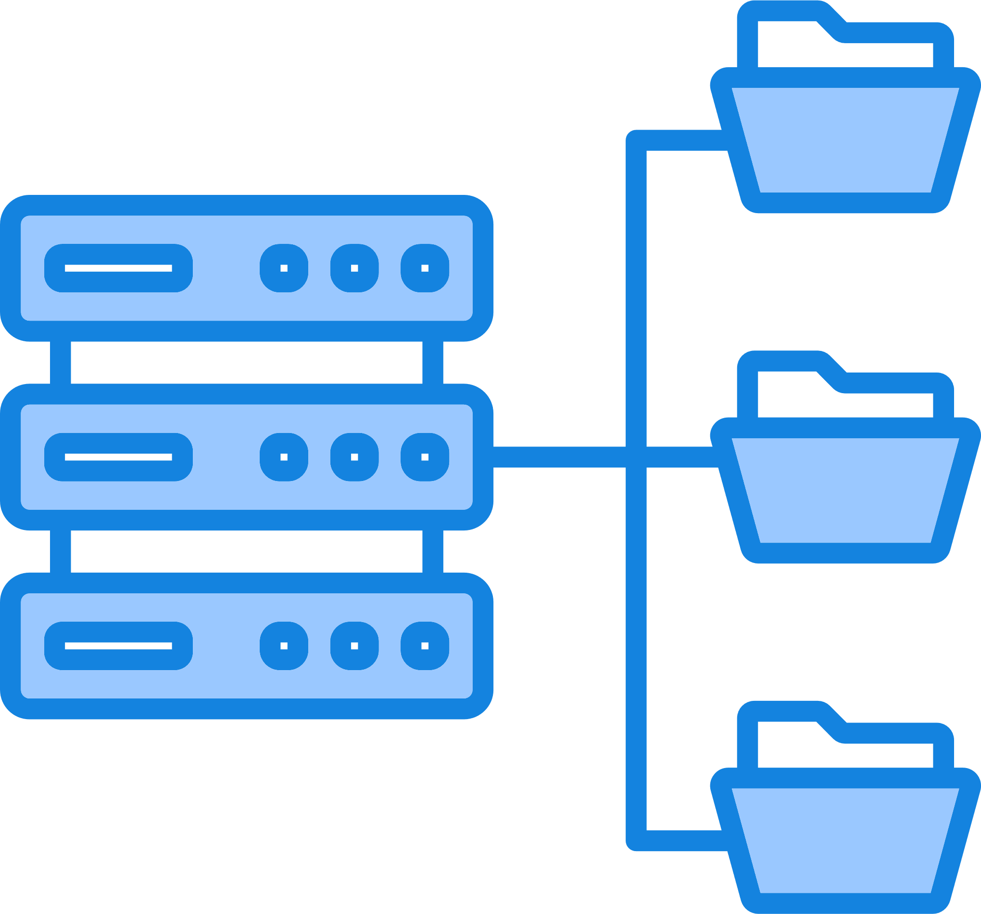
Instructors:
Interal – Arkadi Gorodishtzer
External - Ofer Dangoor
Cloud Based Billing System using Azure & MongoDB
Final Project 2023
Shahak Nir - 207047986
Gal Braymok - 315695981
Sean Peer - 313581613

Slide 2

Abstract
TeleMessage is a communication solutions provider, looking to optimize its billing processes in order to make client's data more accessible.
Recognizing the power and agility of cloud technologies, our final project was conceived – a cloud-based billing system tailored for TeleMessage.
Developed on Microsoft's Azure platform and harnessing MongoDB hosted on Atlas for data management, this solution is primed to address the unique challenges and demands of the telecommunications sector.
With features that emphasize high availability, reduced latency, and paramount data security, this system is more than just a billing solution it's proof of innovation in financial technologies.
Dive in with us as we elucidate the architecture and specialized features

Slide 3
Project Goal
The goal of this initiative was to revolutionize TeleMessage's traditional billing process.
Previously, clients would initiate contact with the finance team to retrieve bills for their past month's service usage.
Recognizing the inherent inefficiencies and the potential to enhance the client experience, we aimed to design a system that would provide clients with instant, seamless access to their past and present usage data.
Furthermore, with the integration of machine learning, our ambition extended to offering clients predictive insights into their future usage patterns, promoting proactive budgeting and usage decisions.
This project was conceived not merely as a billing solution, but as a holistic client empowerment tool.

Slide 4


Challenge & Solution
Big Data Challenge
Selected Solution
The challenge we're addressing pertains to the inefficiencies arising from processing extensive big data within a distributed SQL-based database. This complexity gives rise to suboptimal performance and potential bottlenecks, ultimately hindering smooth data retrieval and analysis. Consequently, this situation compromises the overall efficiency of data processing workflows, making the timely extraction of valuable insights a challenging endeavor.
The core of the project lies in the utilization of refined queries that respond swiftly to client demands, significantly expediting the extraction of information. Concurrently, a learning model is in the process of exploring strategies to efficiently conserve data resources. Simultaneously, it aims to furnish clients with an approximate forecast of their forthcoming month's billing. This predictive estimation is based on the most recent data housed within the database.

Slide 5








Solution Description
01
Client Demands
The project prioritizes addressing specific client demands by establishing a streamlined monthly billing system and offering real-time access to current usage status. Furthermore, it aims to meet client expectations by developing robust tools for evaluating and projecting next month's usage patterns based on existing data.
02
Collecting Data
In phase two, the project undertakes intricate processes for data acquisition and refinement, meticulously addressing predefined queries within the established cloud-based environment.
03
Generating Data
In the third phase, the project focuses on creating aesthetically pleasing data visualizations that are customized to the client's requirements, accentuating the specific features.
04
Clients Use Behavior Learning
In a subsequent phase, the system employs a learning model to detect prevalent client queries. It subsequently formulates new queries for subsequent processing and analysis, effectively adapting to evolving user preferences.

Slide 6
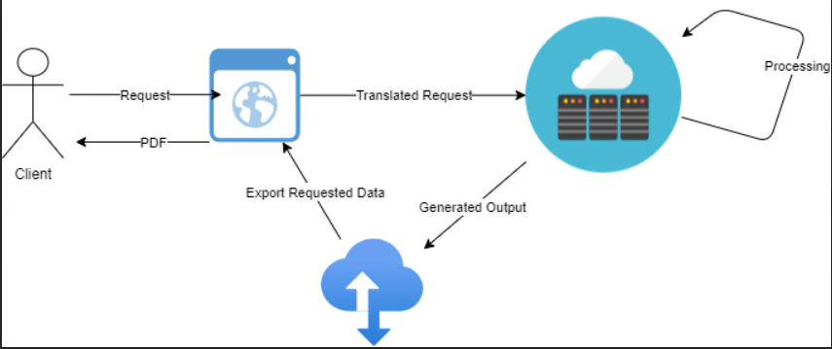
Solution Architecture

Slide 7
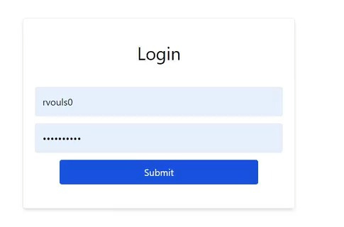
Login Screen
Notes:
- **מסך כניסה:** הלקוח מקיים אינטראקציה עם המערכת על ידי גישה למסך התחברות באפליקציית החזית, אשר פותחה באמצעות React. מסך זה אוסף את האישורים של הלקוח (שם משתמש וסיסמה) ושולח אותם בצורה מאובטחת ל-backend לצורך אימות.

Slide 8
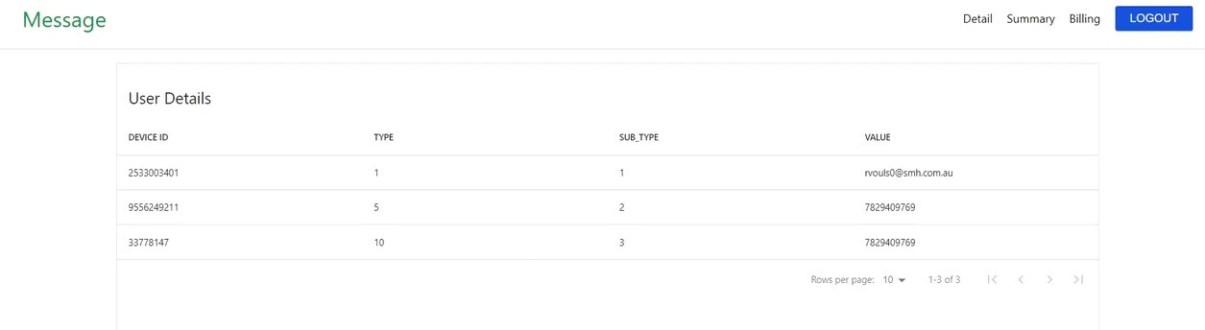
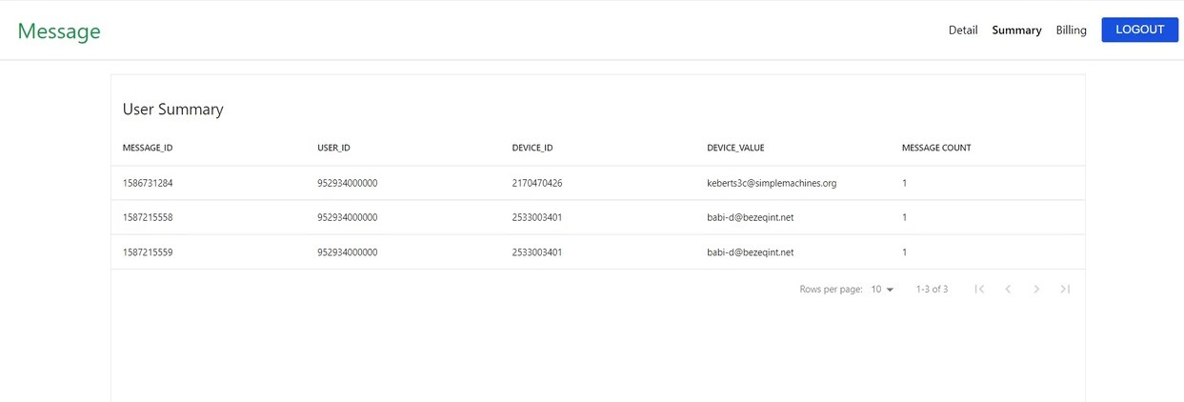
User's Devices
Messages Summary

Slide 9
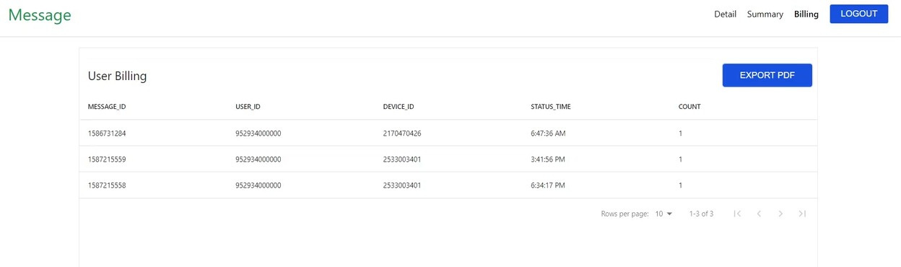
Pre Billing view

Slide 10
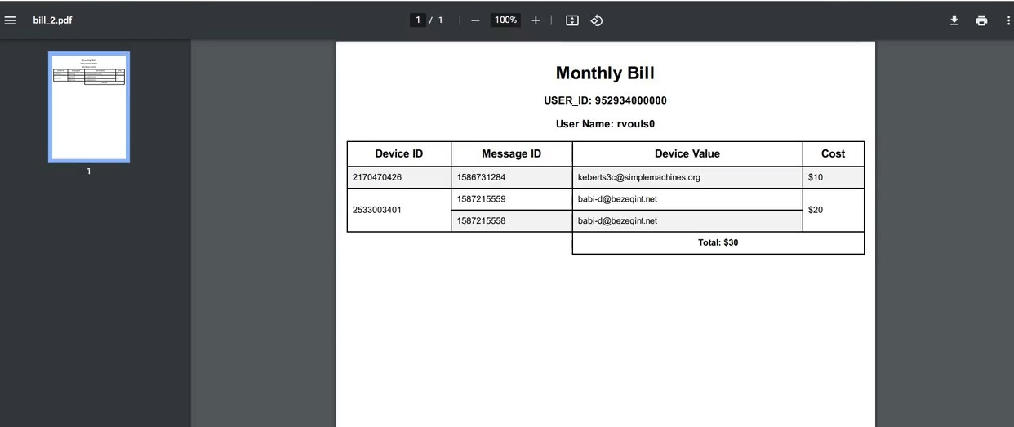
PDF Output

Slide 11
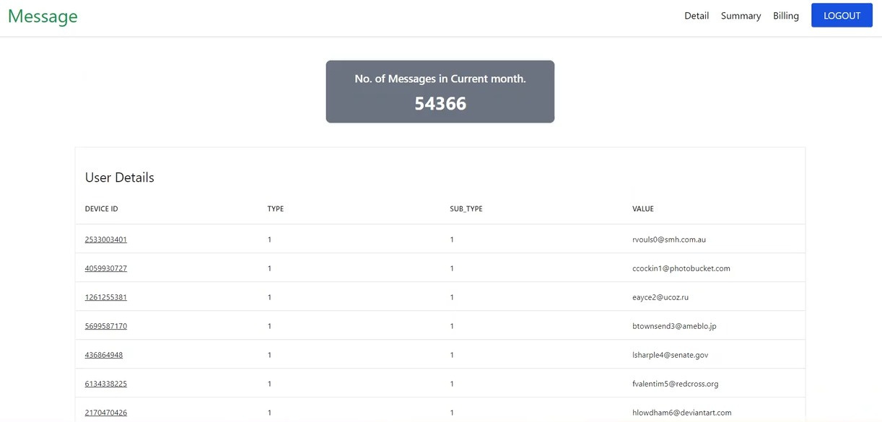
Overall Message Count

Slide 12
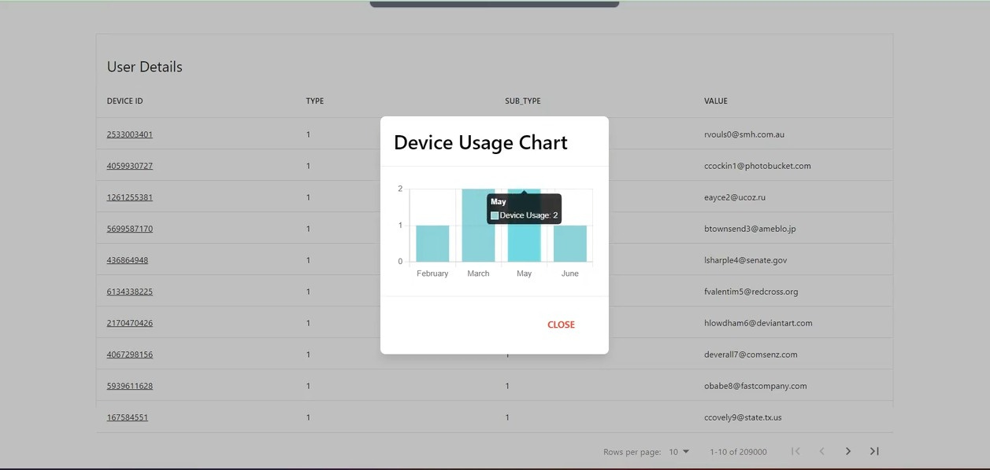
Device Usage per month

Slide 13
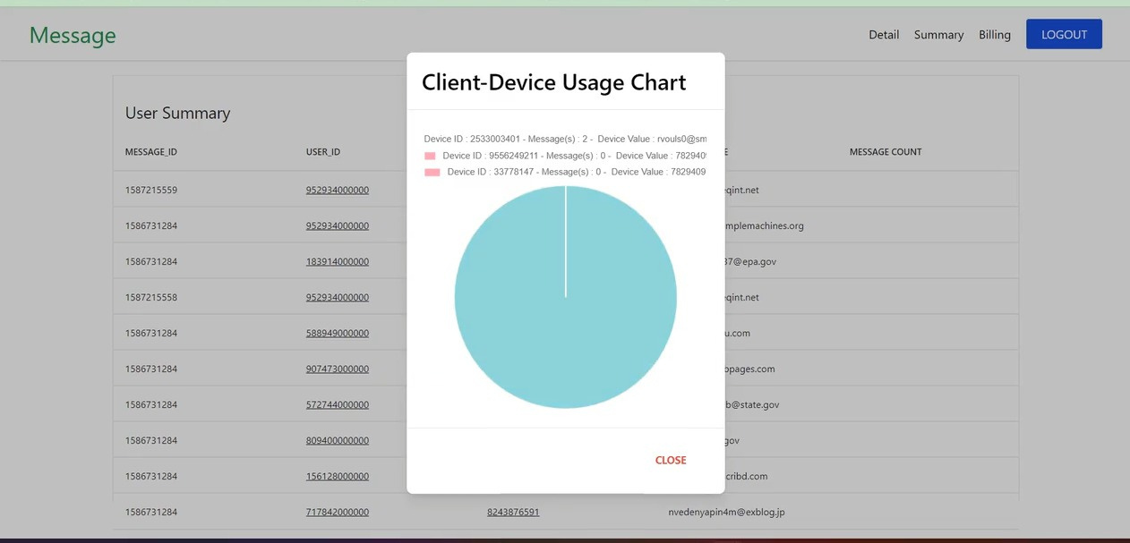
Client Device Usage

Slide 14

Thank You
For Your Attention

